Slide 1


A clustering and analysis of Terrorist attacks
Ryan M. Allen
Regis University
Practicum I Capstone Project

Slide 2
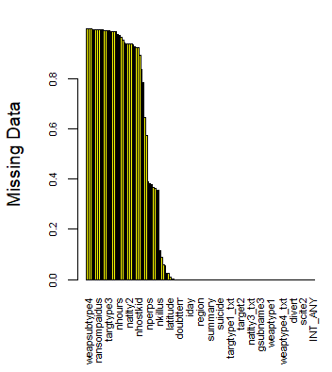
Global Terrorism Database
Maintained by the Study of Terrorism and Responses to Terrorism (START) at the University of Maryland
1970 – 2017
Mostly categorical data
Each row is one terrorist attack
135 features with 180,000+ observations
Notes:
Weapon type, attack type, target type, number of people killed, region, lat/long, criteria for terrorist attack, wounded, hostage, was it a child, who was responsible for the attack, how did they claim responsibility, etc…

Slide 3
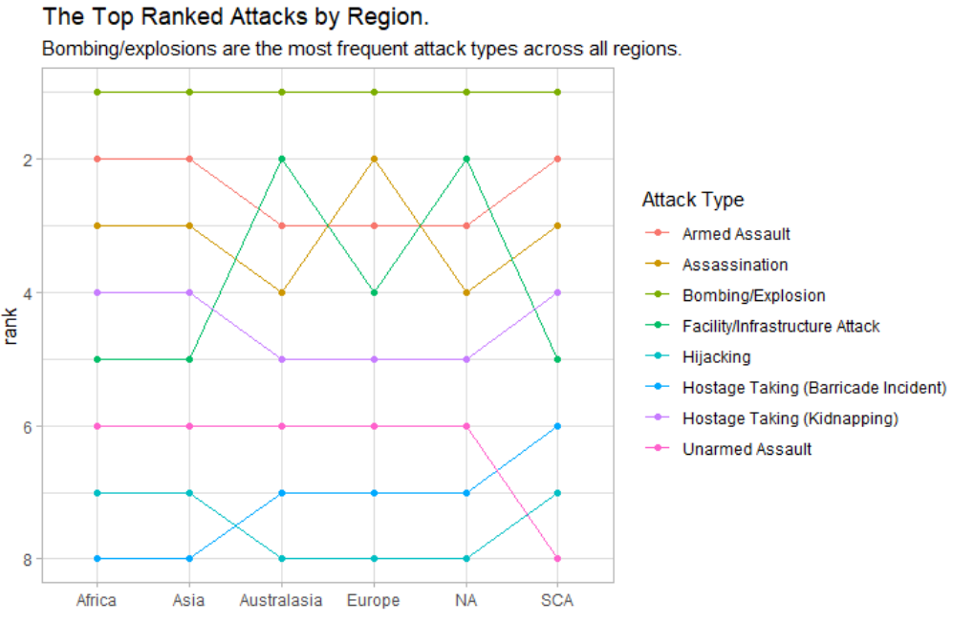
Exploratory Data Analysis

Slide 4
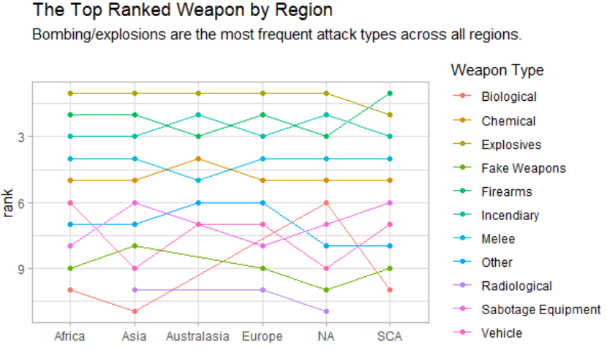
Exploratory Data Analysis

Slide 5
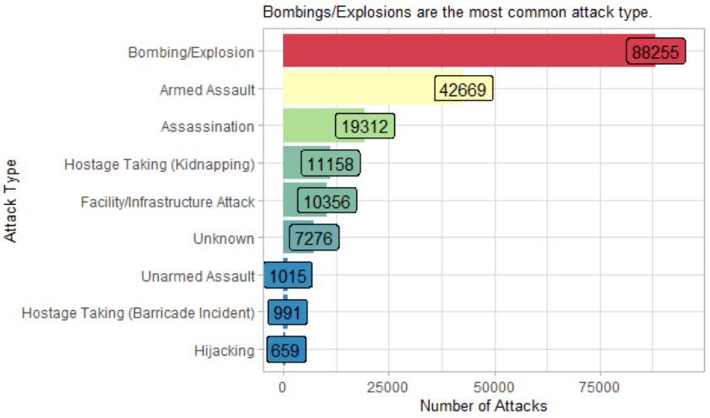
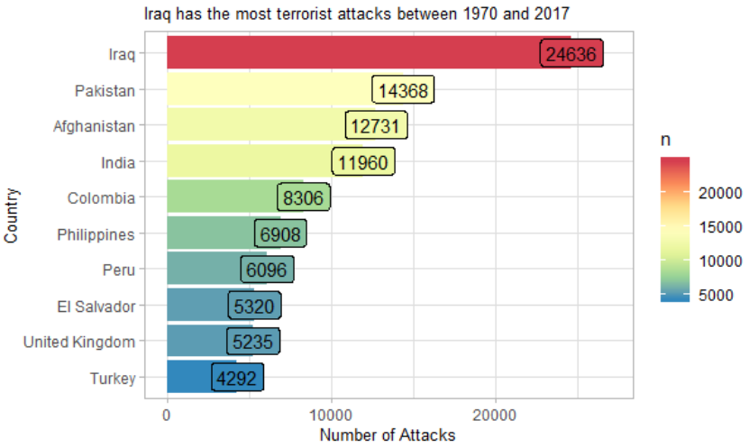
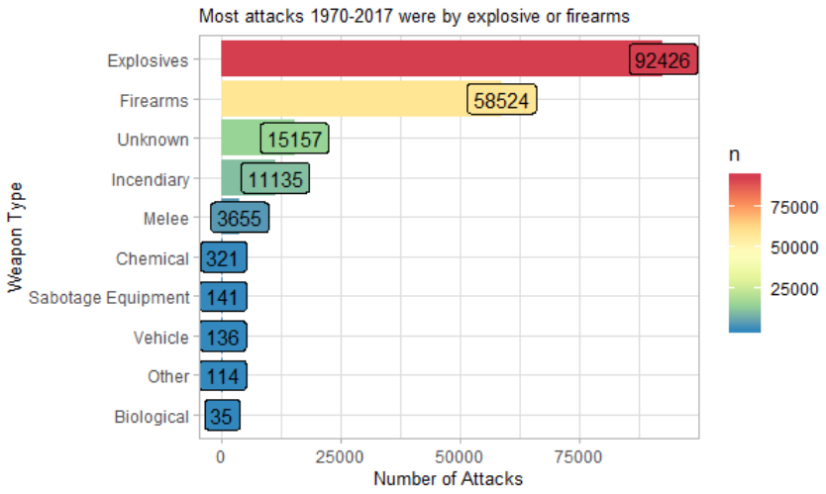
Exploratory Data Analysis

Slide 6
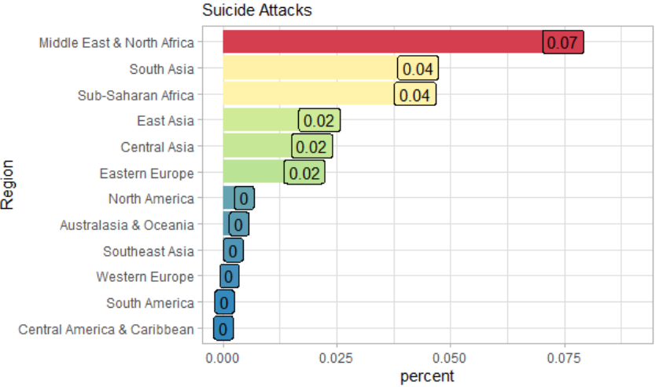
Exploratory Data Analysis
Suicide Rates by Region
Middle East & North Africa = 7.5%
South Asia = 4.3%
Sub-Saharan Africa = 4.2%
East Asia = 2.1%
Central Asia = 2.0%
Easter Europe = 1.8%
North America = <.5%

Slide 7

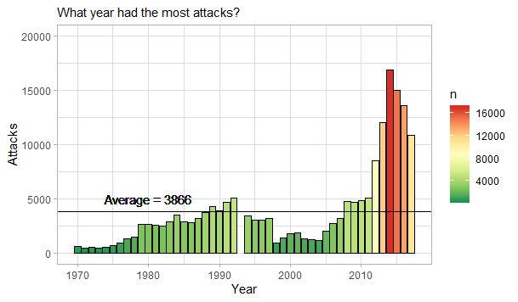
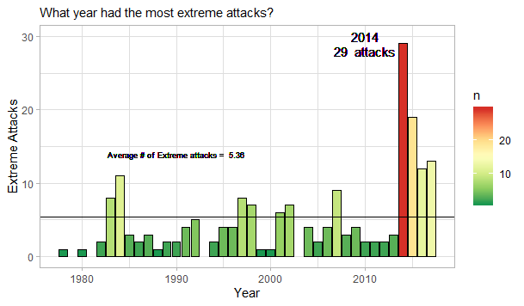
Exploratory Data Analysis
Extreme Attacks vs Attacks over Time
Notes:
People killed over time is very similar to the extreme attacks over time

Slide 8
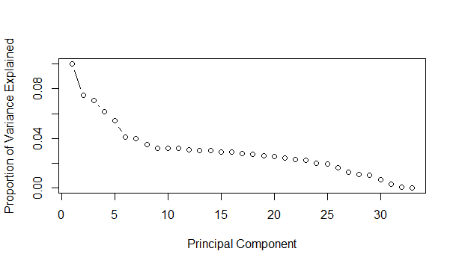
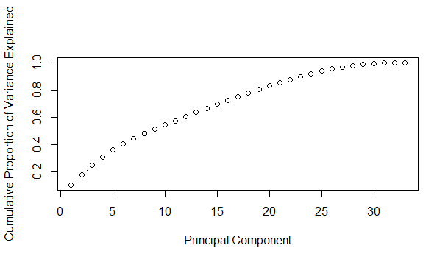
Clustering
PCA and Imputation
Imputation for missing values
PCA for feature selection
28 features ultimately chosen.
Notes:
Scree plot and the Variance explained show how much of the variance of the data is explained where. I chose the first 28 features

Slide 9
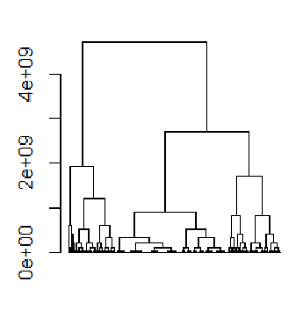
Clustering
Best number of Clusters?
Gap statistic
NbClust
Visually cutting the dendogram
Notes:
Gap stat is the within cluster sum of squares – a metric of error

Slide 10
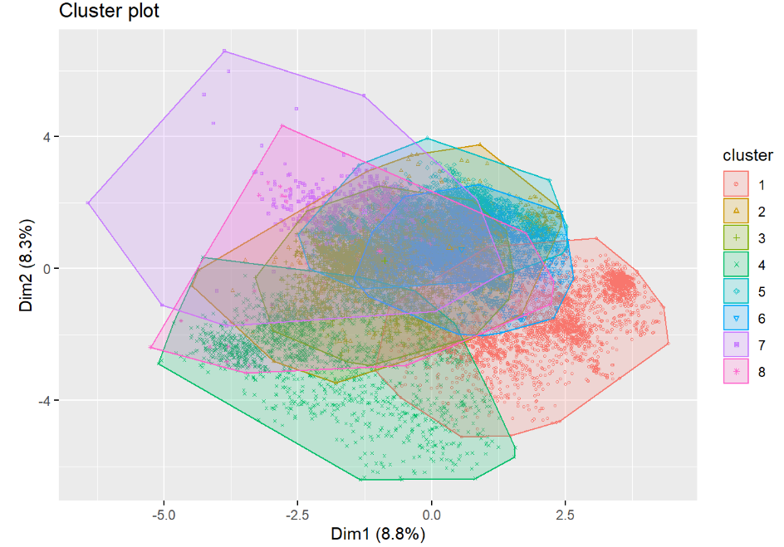
Clustering
Kmeans Clustering
8 centers (based on best clustering)
20 nstart (number of random starts
Notes:
Iteratively assigning records to the nearest cluster until the cluster assignments stop changing. Looks at the distance to the nearest cluster.

Slide 11
Clustering
Hierarchy Clustering
Distance dataframe of the data
Euclidean
Complete linkage method
Notes:
Finds the distance between the pairs of a of clusters and their members. Finds the distance between all the members of one cluster and another and the maximum is reported as the dissimilarity. Clusters that have the smallest dissimilarity are then grouped and the process repeats until one cluster remains.

Slide 12
Clustering
External Measure
Strength of the clustering was a big deal to me, I did not want my clusters to follow along with categorical variables.
I test them against region, weapon type and attack type using the rand statistic in the Cluster Stats.
All centered around 0, suggesting there was no similarity or dissimilarity, which I was hoping for.
Internal Measure
Silhouette Coefficient
Measures average distance between clusters
-1 to 1 high value indicates cluster is well matched and low meaning it belongs to other clusters.
I had no negative coefficients and an average of .56
Notes:
Rand index goes -1 (no agreement) to 1 (total agreement) it checks for similarity between clustering (external measure) internal measures (

Slide 13
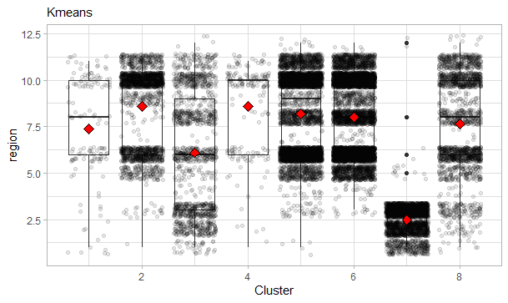
Cluster Exploratory Analysis
Notes:
Cluster 7 has a distinct distribution right around regions 2 and 3, that is the Central and South American region.
Clusters 5 and 7 are heavy in the regions of 5, 6, 8, 10, and 11 (Southeast Asia, South Asia, Western Europe, Middle East and North Africa and Sub-Saharan Africa respectively)
Cluster three has a mean of region 6, South Asia.

Slide 14
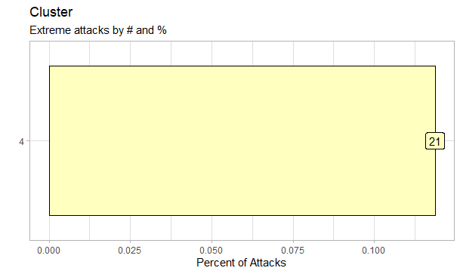
Cluster Exploratory Analysis
Notes:
Cluster 4 had ALL of the extreme attacks. It also represented more than 10% of its attacks.

Slide 15
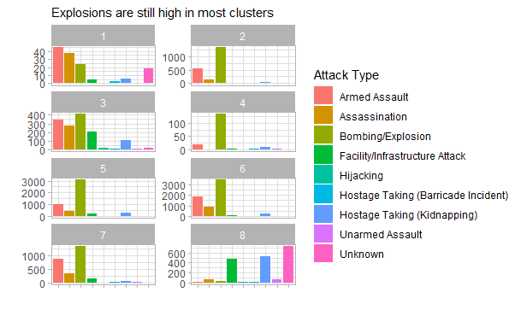
Cluster Exploratory Analysis
Notes:
Rand index goes -1 (no agreement) to 1 (total agreement) it checks for similarity between clustering and

Slide 16
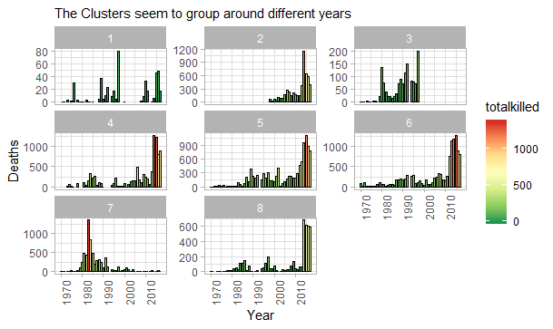
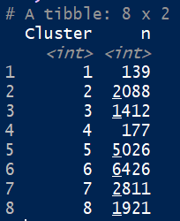
Cluster Exploratory Analysis
Notes:
Clusters 1 and 4 have similar amount of attacks (139 and 177 respectively) but cluster 4 was way deadlier.

Slide 17
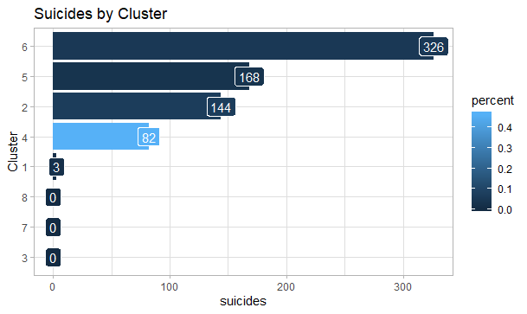
Cluster Exploratory Analysis
Notes:
Even though Cluster 4 does not have the most it has a significantly higher percent of attacks than every other cluster.

Slide 18
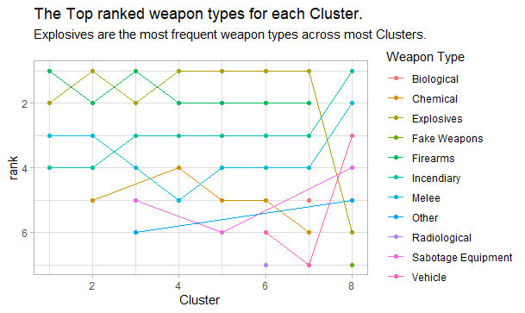
Cluster Exploratory Analysis
Notes:
Showing the dissimilarity between clusters

Slide 19
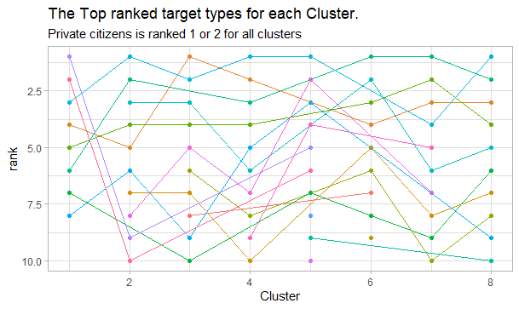
Cluster Exploratory Analysis

Slide 20
Future work and considerations
Cluster
Imputation Methods
Dataset size
Cluster Strength
Notes:
Best number of clusters my gap statistic and NbClust disagreed with the best number of clusters
Imputation is always an area of improvement, research on other imputation methods
Dataset size and how to handle so many rows (had to limit mine to 20K for computation purposes)
Cluster strength (researching and implementing other internal measures of cluster agreement and strength)

Slide 21
Future work and considerations
Further analysis of current database
Other time based datasets for insights
Text analytics and natural language processing
Notes:
Further analysis of current database (creative ways to look at it)
Stock market affects (which causes the other?)
Text field in the database to be analyzed
Combine with other news articles or scraping Twitter to see sentiment analysis around particular terrorist attacks

Slide 22
References
Boehmke, B. (2017, March 03). K-Means Cluster Analysis. Retrieved from UC Business Analytics R Programming Guide: https://uc-r.github.io/kmeans_clustering
Bruce, P., & Bruce, A. (2017). Practical Statistics for Data Scientists. Sebastopol, CA: O'Reilly Media, Inc.
Chang, W. (2013). R Graphics Cookbook. Sebastopol, CA: O'Reilly Media, Inc.
Godlee, J. (n.d.). Spatial Data and Maps. Retrieved from Coding Club: https://ourcodingclub.github.io/tutorials/maps/
Kassambara, A. (2017, August 10). Principal Component Analysis in R: prcomp vs princomp. Retrieved from Statistcal tools for high-throughput data analysis: http://www.sthda.com/english/articles/31-principal-component-methods-in-r-practical-guide/118-principal-component-analysis-in-r-prcomp-vs-princomp/
Mekala, H. (2018, June 29). Dealing with Missing Data using R. Retrieved from Medium: https://medium.com/coinmonks/dealing-with-missing-data-using-r-3ae428da2d17
Oldach, M. (2019, Jan 27). 10 Tips for Choosing the Optimal Number of Clusters. Retrieved from towards data science: https://towardsdatascience.com/10-tips-for-choosing-the-optimal-number-of-clusters-277e93d72d92
Notes:
The following were the resources that were helpful and used throughout the project:
Principal component analysis: (Kassambara, 2017)
Mapping in R: (Godlee, n.d.)
Imputation strategies: (Mekala, 2018)
Optimal Clustering: (Oldach, 2019)
Clustering using gap statistic: (Boehmke, 2017)
Ggplot and visualizations (R Graphics Cookbook): (Chang, 2013)
Practical Statistics for Data Scientists: (Bruce & Bruce, 2017)

